Slide 1

CSE 445 / CSE 598 Distributed Software Development Day One Itinerary
Dr. Yinong Chen
https://myasucourses.asu.edu/

Slide 2
Day One Itinerary
Instructor: Yinong Chen
Course objectives & outcomes
Syllabus discussion
Chapter 1

Slide 3
Instructor: Yinong Chen
Joined ASU CSE in 2001
This Semester:
CSE 230 / EEE 230
CSE 240
CSE 445 / CSE598 / CSE598 Online
Before this semester at ASU
CSE 101/FSE100: Every semester from Fall 06 to Fall 11
CSE230 F11, F12, S13, F13, F14
CSE 240: F01, S02, F02, S03, F03, S03, SS04, F04, S05, F05, S06, S07, S12, S13, F13, F14
CSE 310: SS01, F01, SS02
CSE 225/EEE225: F02, S03, F03, S04, CSE 330: S2002, SS 2003 CSE 420/598: S01
CSE 423 (Capstone) S08, F09
CSE 445/598: Almost every semester since 2006 CSE 446/598 (Software Integration & Eng): SS10, SS11, Sp11, SS12, SS13, Sp14

Slide 4
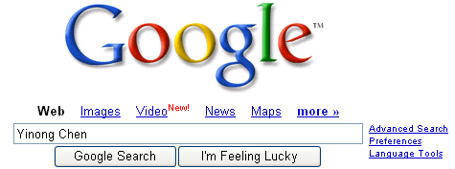
Yinong Chen
Before joining ASU
Taught for six years Department of Computer Science Wits University of Johannesburg, South Africa
Postdoc at LAAS-CNRS, Toulouse, France
Ph.D. from the Karlsruhe Inst. of Tech. (KIT), Germany
Contact and more … http://www.public.asu.edu/~ychen10/
Heinrich Hertz worked at KIT (UoK) from 1885 to 1888, where he discovered electromagnetic waves

Slide 5

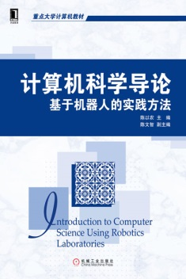






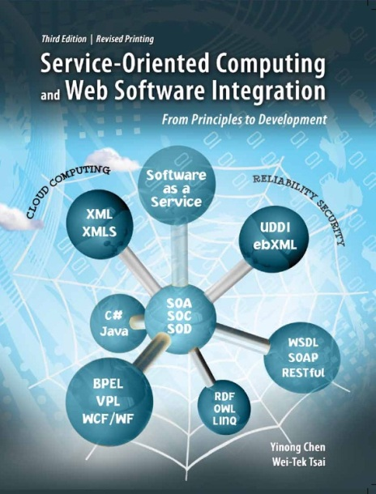
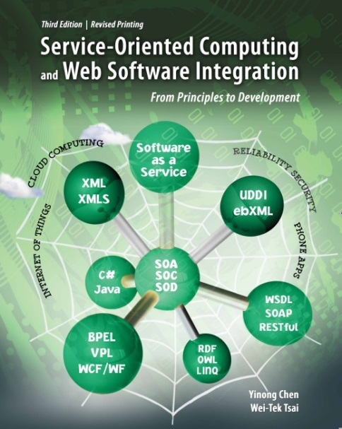
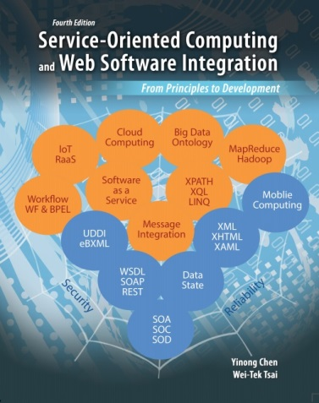

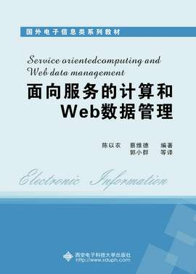
Yinong Chen
Dozen books
160 research papers, 80 of which are after 2005 in service-oriented computing
Editor of international journals
Chair of international conferences
Keynote, panel talks
Teach high school students to program robots
2012
2012
2006
2008
2003
2014
2014
2013

Slide 6
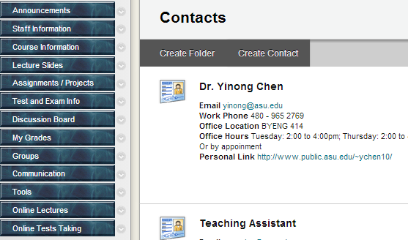
Office Hours: Please Check Course Web Page, Staff Information
Check

Slide 7
The New CSE 445/598 since 2006
Title
CSE 445/598 Distributed Software Development
Catalog Description
Distributed system architectures and design, service-oriented computing, and frameworks for development of distributed applications and software components
Course Syllabus
http://www.public.asu.edu/~ychen10/teaching/cse445/
Textbook Approved in Spring 2008
The book (4th Ed.) 2014 will be heavily used
2014

Slide 8
ASU is a Leader in SOA Education
The new SOA-based CSE445/598 title and contents started in Fall 2006. The change was initiated and approved by:
CSE Software Engineering Concentration Committee
CSE Undergraduate Program Committee (UPC)
CSE Faculty Assembly
Developing a new course is a serious issue, needs the commitment from the school, and requires significant efforts from many faculty members.
ASU is playing a leading role in SOA education, from high school to graduate school
CSE446/598: Software Integration & Engineering, Spring 2012 The course will use Part II of the same text (3rd Edition)
Offered in every spring
Prerequisite: CSE445/598!

Slide 9
Course Objectives and Outcomes
1. To develop an understanding of the software engineering of programs using concurrency and synchronization
The student can identify the application, advantages and disadvantages of concurrency, threads and synchronization.
The student can apply design principles for concurrency and synchronization.
The student can design and write programs demonstrating the use of concurrency, threads and synchronization.

Slide 10
Objectives and Outcomes
2. To develop an understanding of the development of distributed software
The student can recognize alternative distributed computing paradigms and technologies.
The student can identify the phases and deliverables of the software lifecycle in the development of distributed software.
The student can create the required deliverables in the development of distributed software in each phase of a software lifecycle.
The student understand the security and reliability attributes of distributed applications

Slide 11
Objectives and Outcomes
3. To develop an ability to design and publish services as building blocks of service-oriented applications
The student understand the role of service publication and service directories
The student can identify available services in service registries.
The student can design services in a programming language and publish services for the public to use.

Slide 12
Objectives and Outcomes
4. To build skills in using a current technology for developing distributed systems and applications
The student can develop distributed programs using the current technology and standards.
The student can use the current framework to develop programs and web applications using graphical user interfaces, remote services, and workflow.

Slide 13
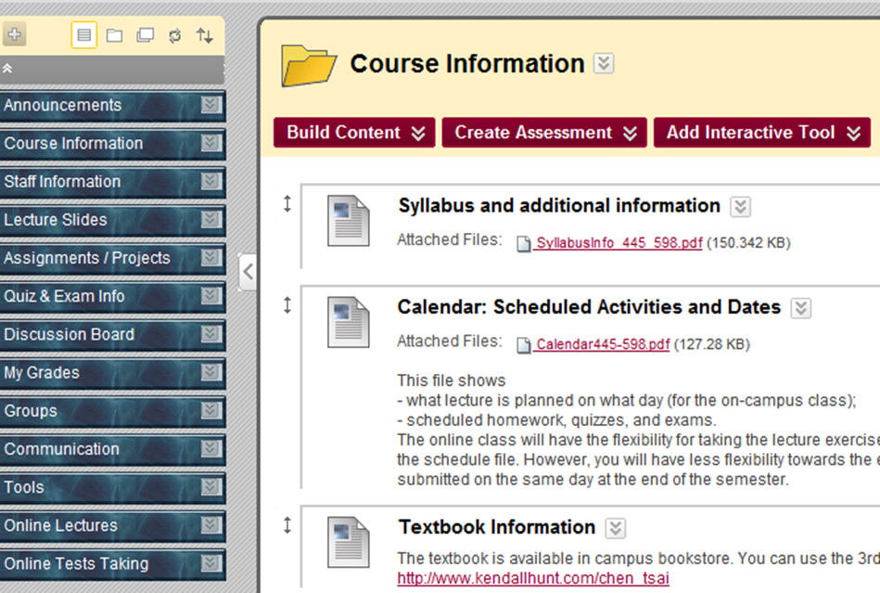
https://myasucourses.asu.edu/Blackboard
Polling vs. Event-driven

Slide 14
Weight and Grading Scale
Lecture Exercises & quizzes will be given online for all students too. You can take them in the lecture week.
Percentage | Symbol Grade
96.5-100% 92.5-96.4% 89.5-92.4% | A+ A A-
86.5-89.4% 82.5-86.4% 79.5-82.4% | B+ B B-
75.5-79.4% 69.5-75.4% | C+ C
59.5-69.4% | D
Below 60% | E
Graded Activity | Weight
Assignments | 30%
Lecture Exercises* | 11%
Quizzes 1, 2, 3, 4, 5* | 12%
Mid-Term Exam | 22%
Final Exam | 25%
* The lowest one will be dropped. You can request to reset one test if your internet connection broke.

Slide 15
Standard Classroom Expectation
Silent your cellular phone; If your phone happens to ring, stop it immediately and do not answer your phone!
Use computer for directly related activities only, e.g., taking notes. No computer is allowed during any tests (lecture exercises quizzes, exams).
Do not talk to each other during the lecture. If you have a question that needs to be resolved immediately, you must ask the instructor.
Enter the classroom before the lecture’s starting time.
Do not leave the classroom during the lecture, unless there is an emergency situation.

Slide 16
Policies
Interaction: You are encouraged to ask the instructor questions during the lectures.
Outside class help welcome and encouraged:
Discussion board (effective and fair);
Instructor’s and the TA’s office hours;
Request appointments if you can not make the office hours;
Email/phone call, if necessary.
Tests and exams: Missing tests and exams will be giving zero credit and may not be made up.
Assignments: Late submission will be accepted with grade deduction: 1% of grade deduction for every hour after the due time.

Slide 17
Extra credit, alternative, and inquires
No extra credit-activities will be given to any individual. Extra credit-activities may be given to the entire class.
An alternative to a graded activity may be arranged if a student's absence is caused by documented illness or personal emergency. A written explanation (including supporting documentation) must be submitted to the instructor before the part of work is due or as soon as the circumstances are known.
Any inquires or appeals on grades of homework, projects, or tests must be done in writing by completing the "Grade Inquiry Form" within a week from the day the grades and/or comments were published on-line. State the problem and the rationale for any change in grade in your appeal

Slide 18
Cooperation and Code of Conduct
You are encouraged to cooperate in study group on learning the course materials.
You may not cooperate on preparing the individual assignments. Anything you turn in must be your own work. If you use an idea that is found in a book or other sources, make sure you acknowledge the source and/or the names of the persons in the write-up for each problem.
All assignment questions must be asked in the course discussion board. Asking assignment questions or making your assignment available in the public websites before the assignment due will be considered cheating.
The instructor and the TA are required to CAREFULLY check any possible proliferation or plagiarism. We will use the software tools like MOSS (Measure Of Software Similarity) to check any assignment. The university expects all students to adhere to ASU's policy on Academic Dishonesty. These policies can be found in the Code of Student Conduct:
https://provost.asu.edu/academicintegrity/policy
ALL cases of cheating or plagiarism will be handed to the Dean's office. Penalties include a failing grade in the class, a note on your official transcript that shows you were punished for cheating.

Slide 19
Fulton Schools of Engineering Honor Code
http://engineering.asu.edu/integrity/honor-code/
Seek out, acquaint myself with, and obey the instructor’s rules concerning the materials I am allowed to use and the types of collaboration in which I am permitted to engage in each of my courses.
Help my fellow engineering students to succeed both academically and professionally, while both following the instructor’s guidelines on collaboration and encouraging my classmates to behave ethically.
Ensure that all of my individual work products reflect my own abilities and not those of someone else. I will never copy the work of others or give others the opportunity to copy mine.
Contribute a fair share of work to all teamwork in which I participate, and acknowledge the contributions of others. I will accept responsibility for the integrity of all work submitted by my team.
Use only aids authorized by the instructor during all examinations, quizzes, projects, assignments and other evaluations.
Provide aid to, or receive aid from other students only as permitted by the instructor.

Slide 20
Fulton Schools of Engineering Honor Code
http://engineering.asu.edu/integrity/honor-code/
Give full credit to others for their words and ideas, whether directly quoted or paraphrased, using proper citation practices in all of my work, including text, figures and computer code, and all materials obtained from the Internet.
Never act dishonestly including lying, cheating, stealing, or attempting to corrupt the academic enterprise in any way.
Ensure that all data I record or report are objective, true, accurate and properly documented.
Treat all students, faculty and staff with respect, courtesy and dignity, the way I would like to be treated myself.
Recognize that it is how I act when no one else is watching that defines my true character.
Act at all times with integrity, as the true professional that I am to become.

